Slide 1
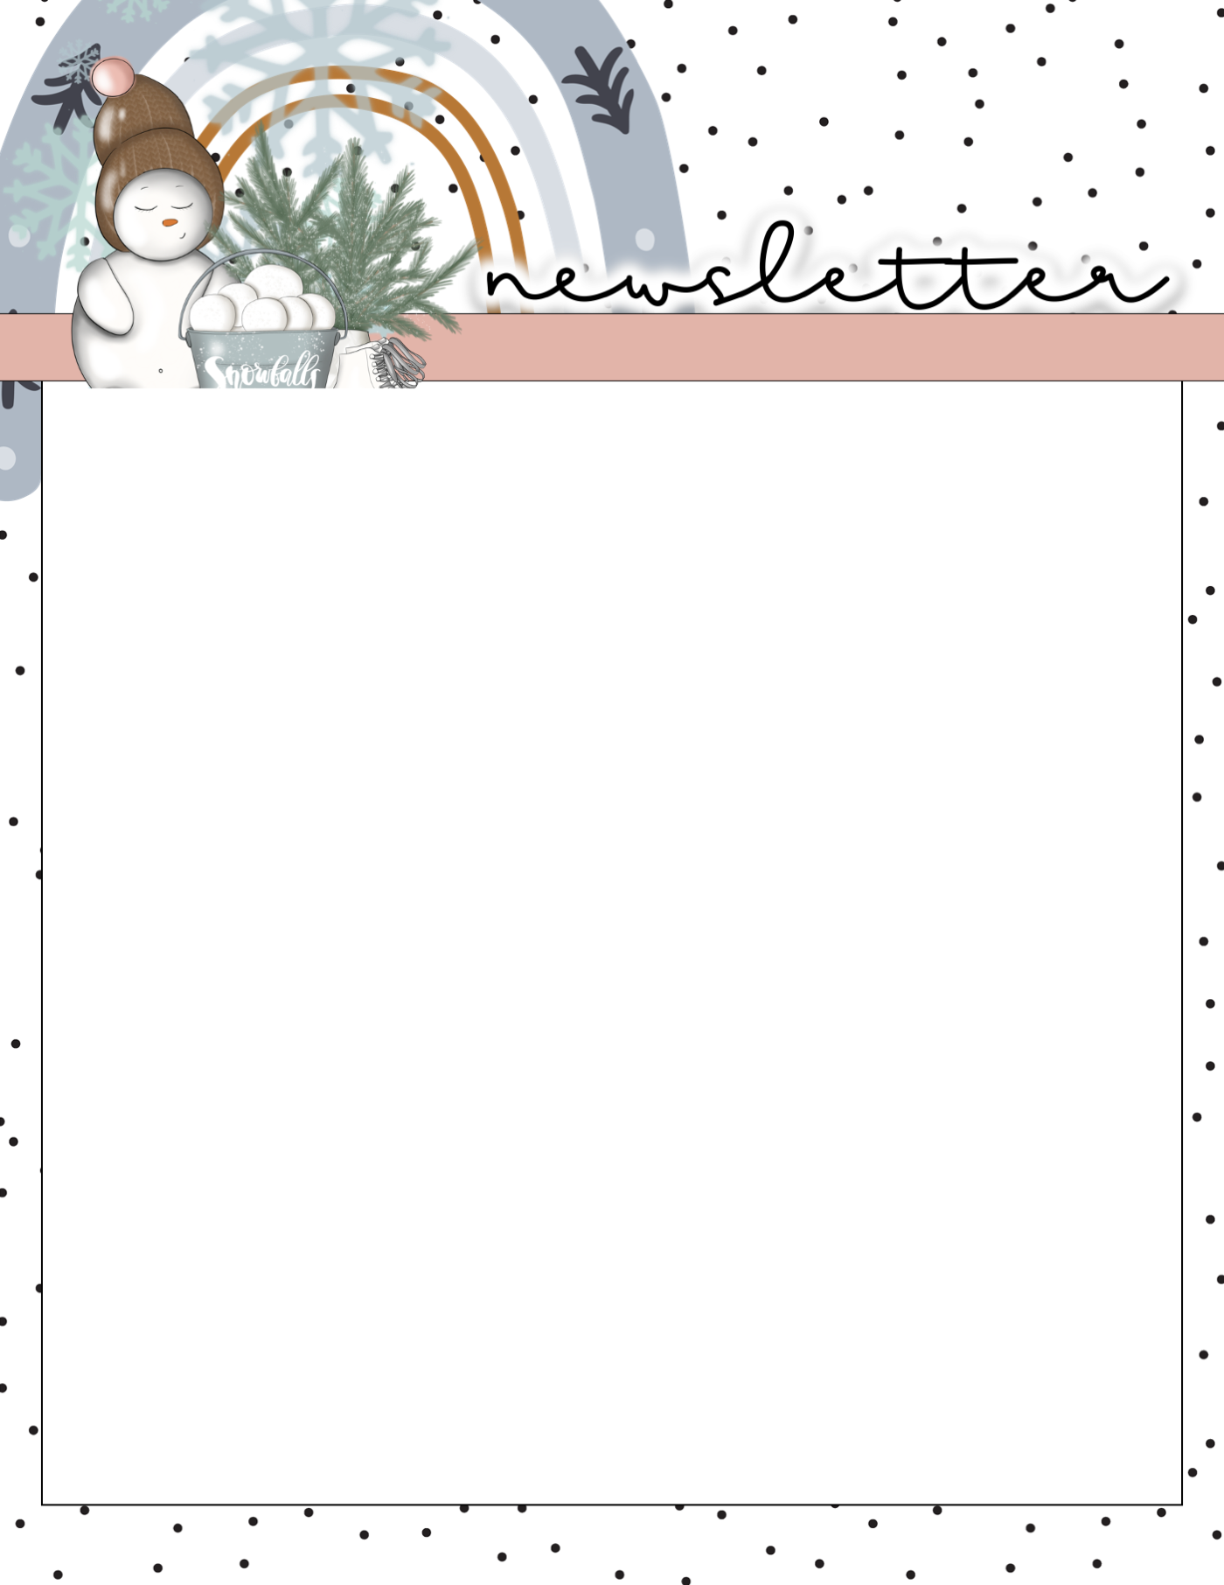
Mrs. Peacock’s
January 16-19 , 2024
Weekly Skills
Coming up @ NSE
ELA: Recount fables and folktales and determine the central message or lesson
PHONICS: Review previously taught skills
MATH: Skip Counting
LANGUAGE: Adjectives
Science: Earth and Space
100th Day of School - 1/19
Deadline to order a yearbook is Thurs., Feb. 29th.
Phonics Skill OF THE WEEK
VOCABULARY
We will be reviewing previously taught skills this week- no test
**vocab test will be 1/26**
Replace- to take the place of; to substitute one thing for another.
Lesson- what the story teaches the reader; something to be learned.
Illustration- a picture that helps us understand a text
Paragraph- a series of sentences that share a common idea.
Phrase- a group of words that work together in a sentence.
Reminders-
Please send a water bottle & snack daily!
Homework/Tests-
Homework- reading, math, & facts
Tests- No spelling or vocabulary test this week!

